Slide 1


NLP - Part 2: LLMs
Motaz Saad

Slide 2

Copyright Notice
These slides are distributed for educational purpose under the Creative Commons License. https://creativecommons.org/licenses/by-sa/2.0/legalcode
Source of Slides:
DeepLearning.AI as the source of the slides.
Generative AI :)
Harvard Teaching and Learning Consortium

Slide 3
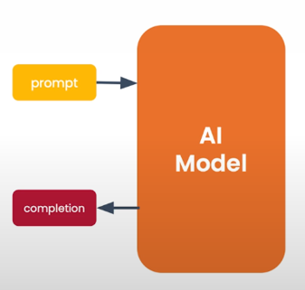
What is generative AI?
Gen AI is an Artificial intelligence systems that can produce high quality content, specifically text, images, and audio.

Slide 4
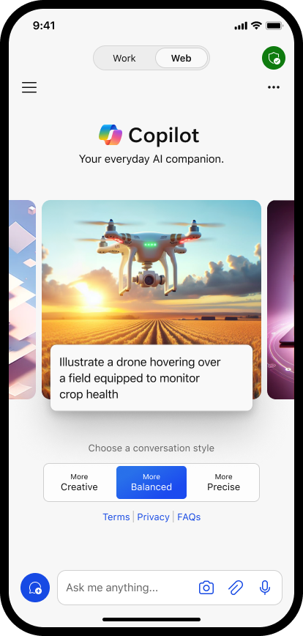
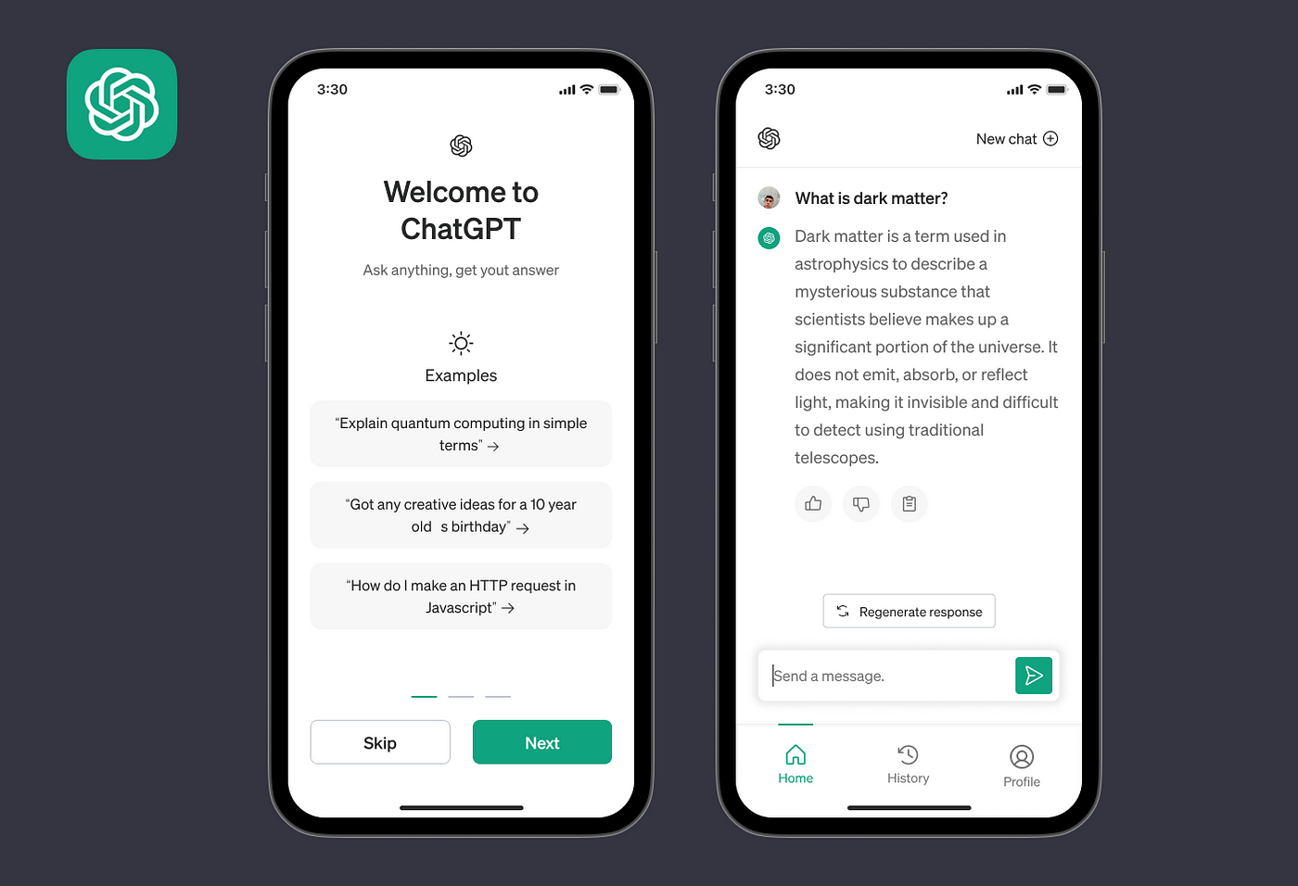
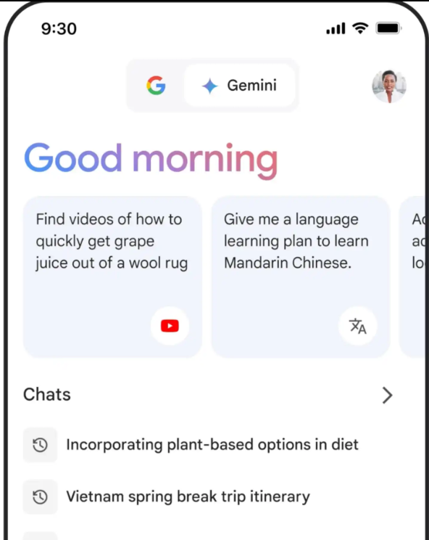



Gen AI Tools for end users (mobile App)

Slide 5

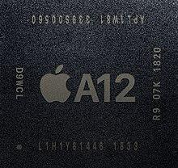
Processors with Neural Engine

Slide 6
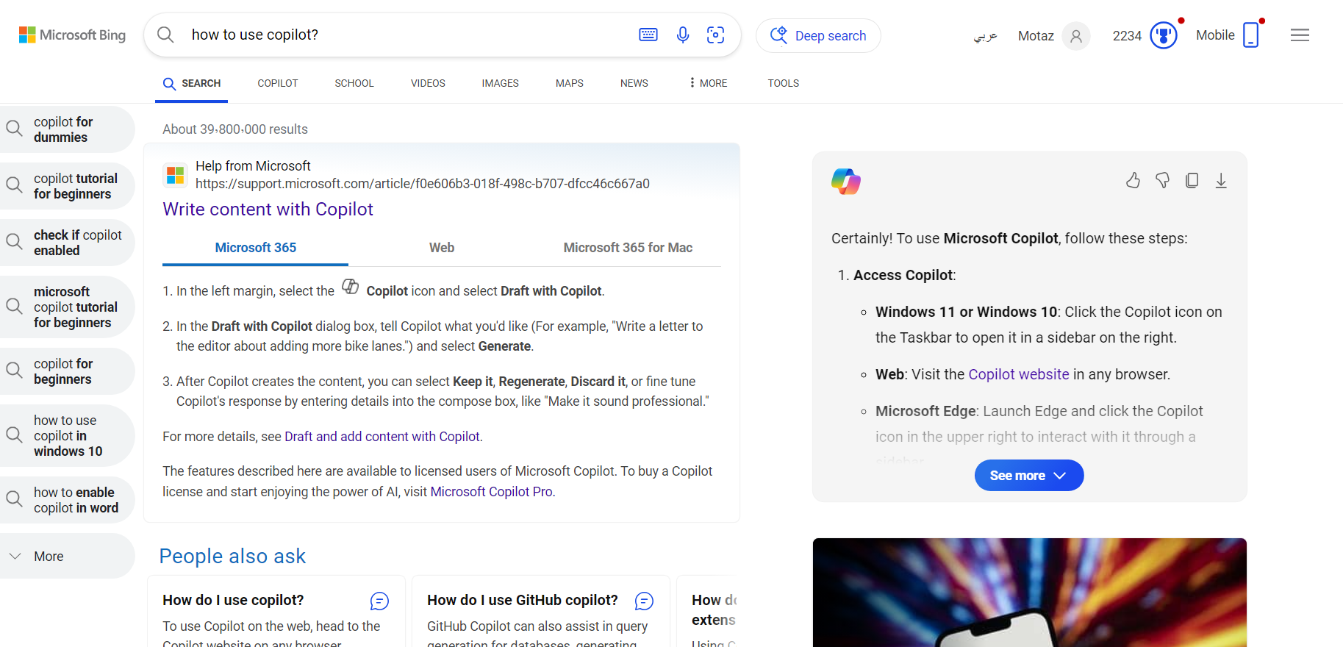
Gen AI Tools for end users (Copilot Web App)

Slide 7
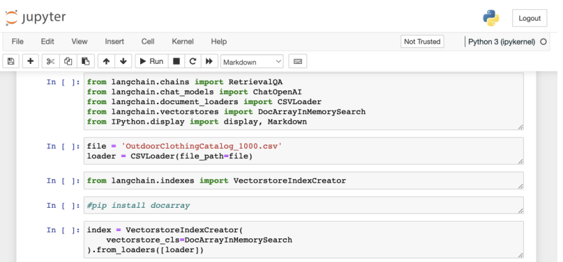
Generative AI is also a developer tool

Slide 8
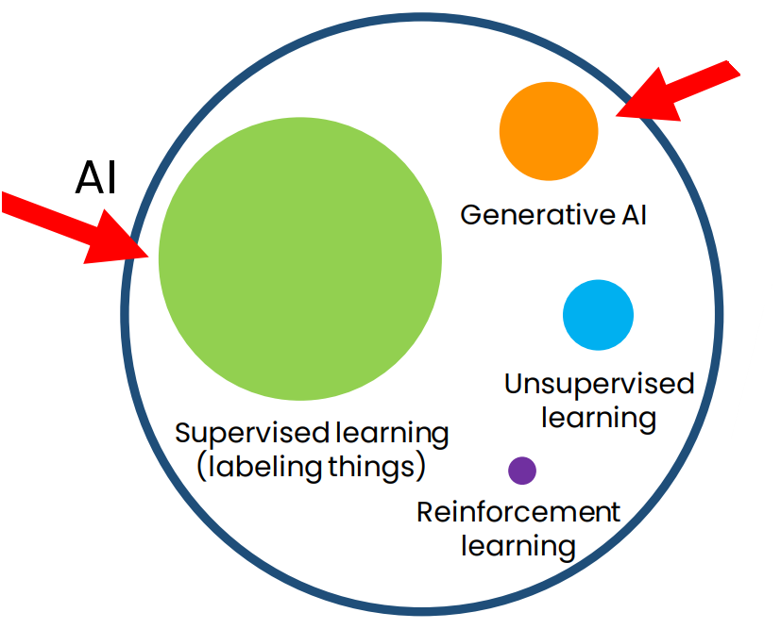
How generative AI works
AI is a set of tools

Slide 9
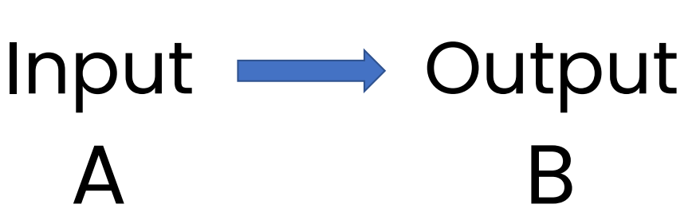
Supervised learning (labeling things)

Slide 10
Supervised learning (labeling things)
Input (A) ) | Output (B | Application
Email | Spam? (0/1) | Spam filtering
Ad, user info | Click? (0/1) | Online advertising
X-ray image | Diagnosis | Health-care
Image of phone | Defect? (0/1) | Visual inspection
Audio recording | Text transcript | Speech recognition
Restaurant reviews | Sentiment (+/-) | Reputation monitoring

Slide 11
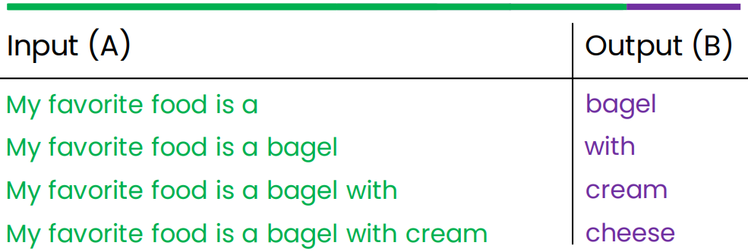
How LLMs work?
LLMs are built by using supervised learning (A→B) to repeatedly predict the next word.
My favorite food is a bagel with cream cheese
When we train a very large AI system on a lot of data (hundreds of billions of words), we get a Large Language Model like ChatGPT.

Slide 12
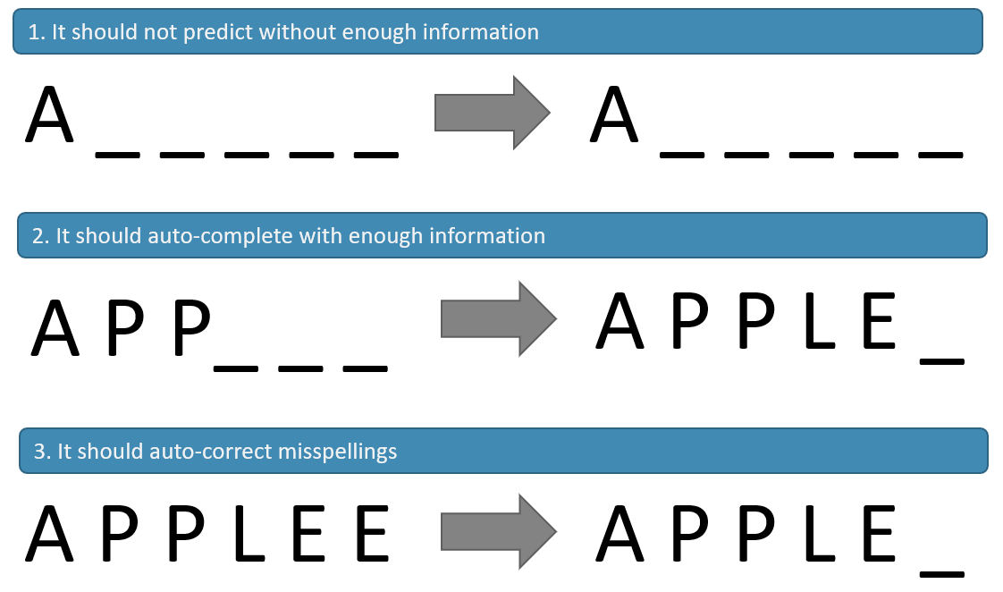
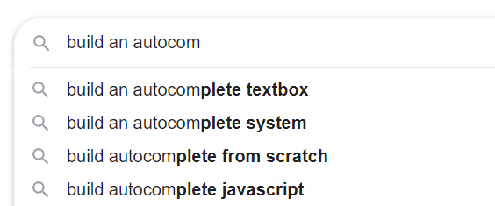
The Language Model

Slide 13
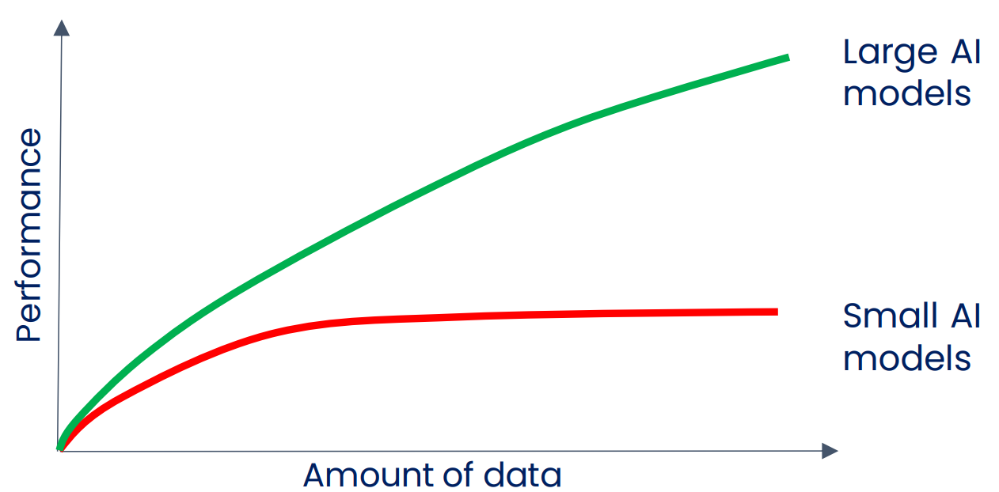
2010-2020: Large scale supervised learning

Slide 14
Large Language Models (LLMs)

Slide 15
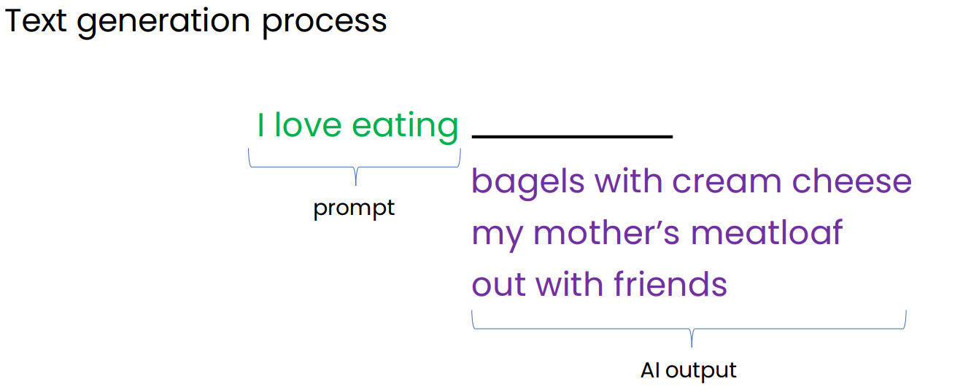
Generating text using Base LLM

Slide 16
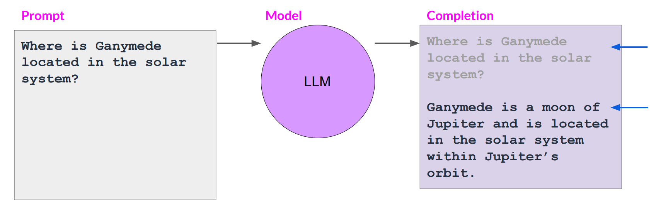
Prompts and completions
Context windows = # of tokens of (prompt + completion)

Slide 17



How LLMs work?
how to predict the next word?
learn from a huge text data such as books, Wikipedia, news articles, papers, magazines, ... etc.

Slide 18
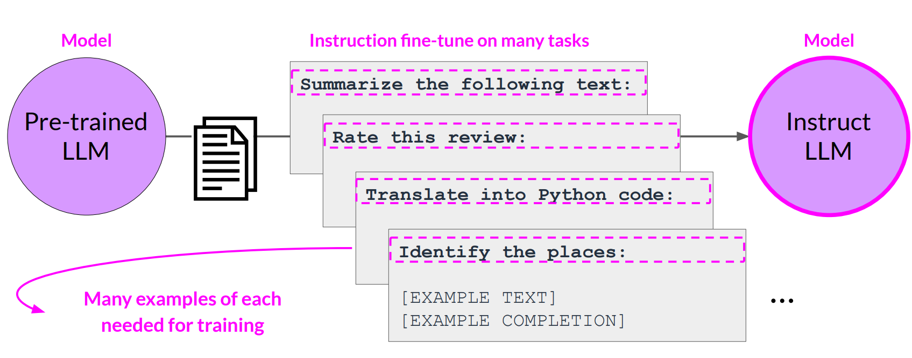
Multi-task, instruction fine-tuning

Slide 19
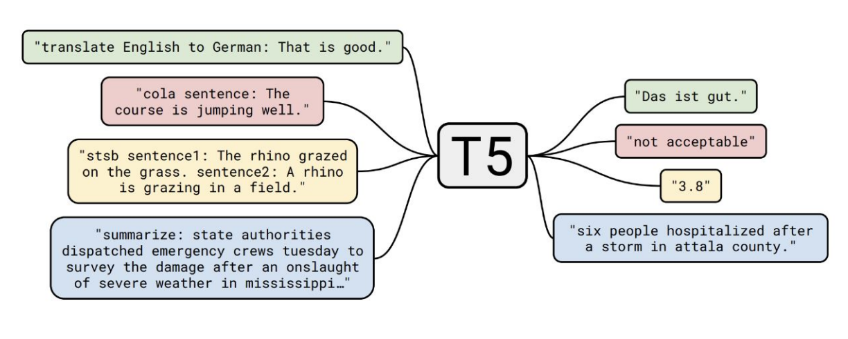
T5 LLM model used for several tasks

Slide 20
Types of LLMs
LLMs
Base LLM
Instruct LLM

Slide 21
Types of LLMs
Base LLM
Instruct LLM
Predicts the next word based on text training data.
Questions posed to Base LLM (no answers provided):
follow instructions but doesn’t always provide accurate answers.
Fine-tuned on instructions and good attempts at following them.
LLMs Reinforcement Learning with Human Feedback (RLHF)
Quality is measured via 3 measures
Helpful, Honest, Harmless: HHH
“Once upon a time, there was a unicorn that lived in a magical forest with all her unicorn friends.”
“What is the capital of France?
What is France’s largest city?
What is the currency of France?”
“What is the capital of France?
The capital of France is Paris.”

Slide 22
Helpful, Honest, Harmless: HHH
Helpful: Refers to the model’s ability to provide useful and relevant information or assistance.
Honest: Indicates that the model’s responses are truthful and transparent. When the model provides an answer, it aims to be honest rather than misleading or deceptive.
Harmless: Implies that the model’s outputs are not harmful or malicious. It won’t intentionally cause harm or negative consequences through its responses

Slide 23
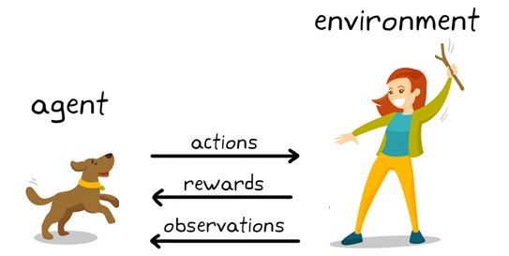
Reinforcement Learning

Slide 24
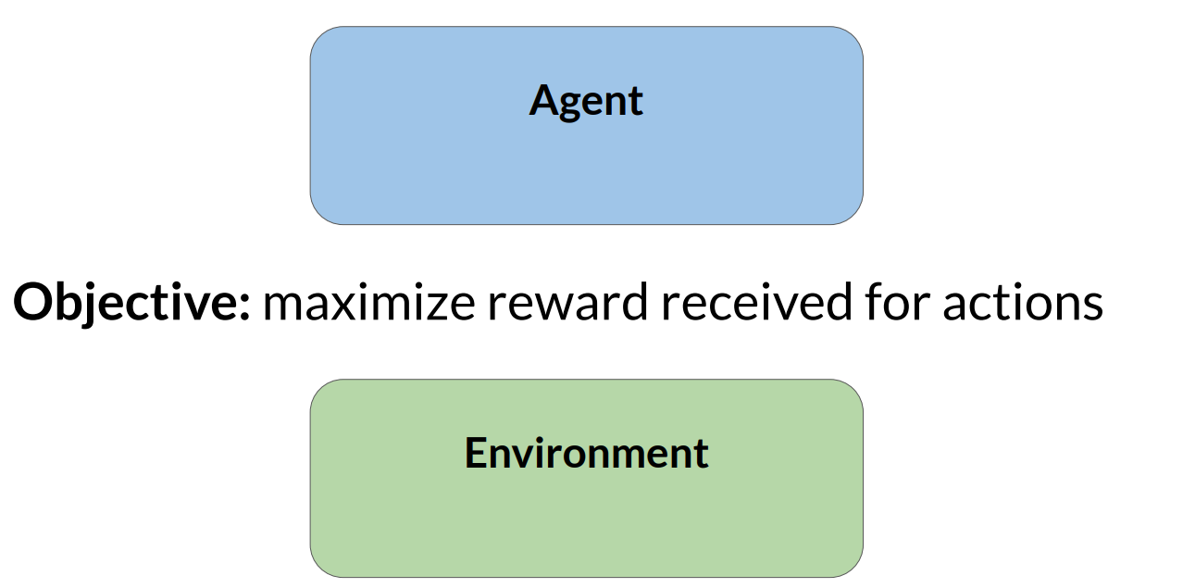
Reinforcement learning (RL)

Slide 25
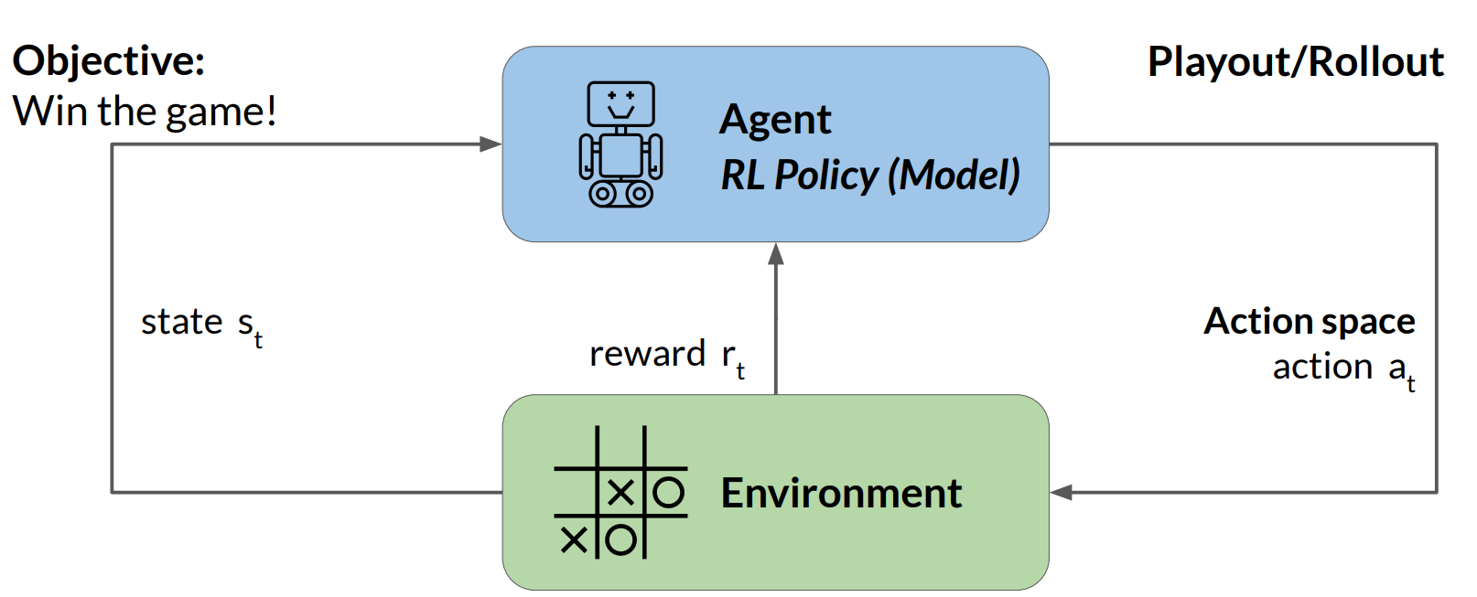
Reinforcement learning: Tic-Tac-Toe

Slide 26
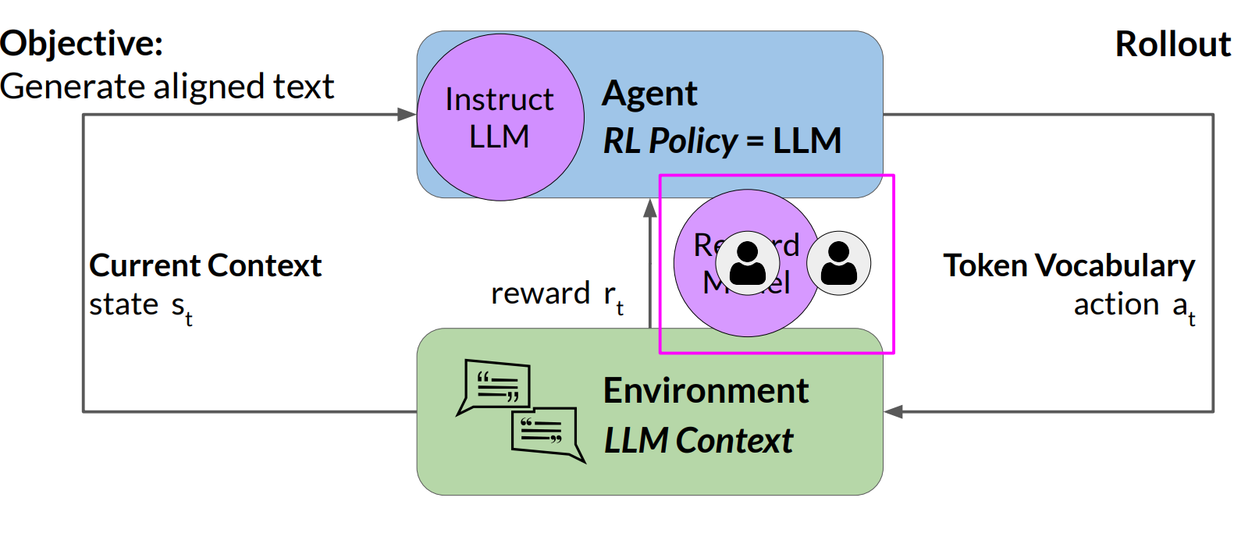
Reinforcement learning: fine-tune LLMs

Slide 27
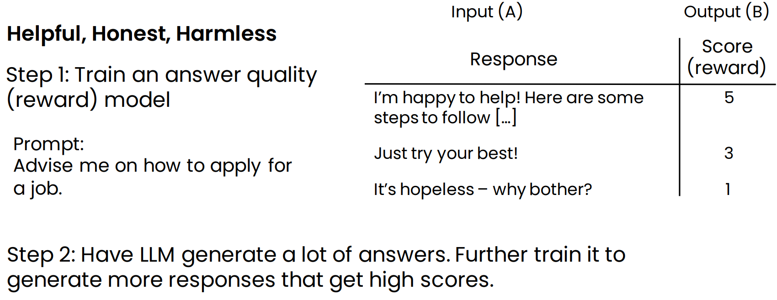
How do chat systems learn to follow instructions?
Reinforcement learning from human feedback (RLHF)

Slide 28
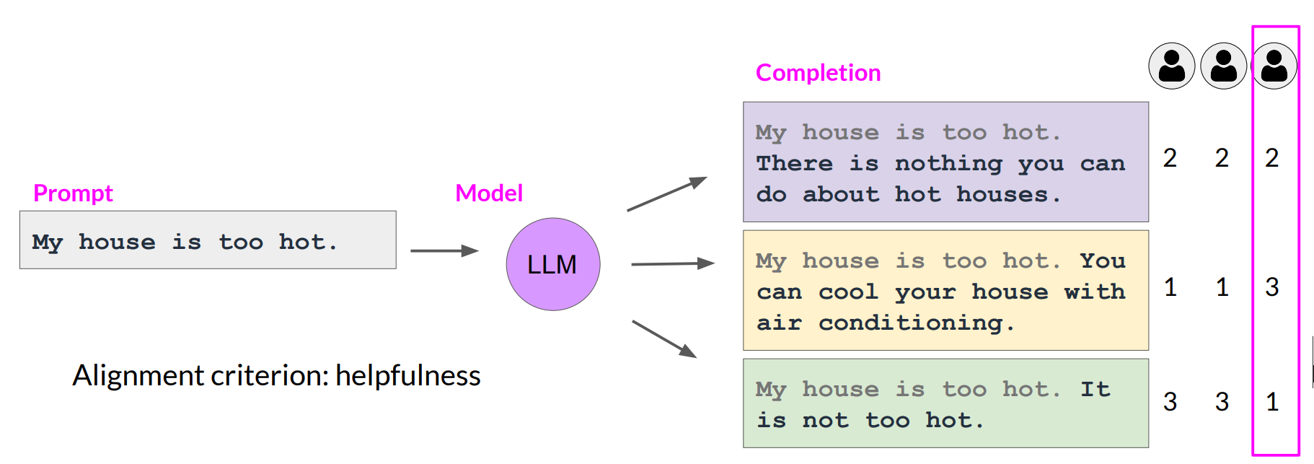
Collect human feedback
Define your model alignment criterion
For the prompt-response sets that you just generated, obtain human feedback through labeler workforce

Slide 29
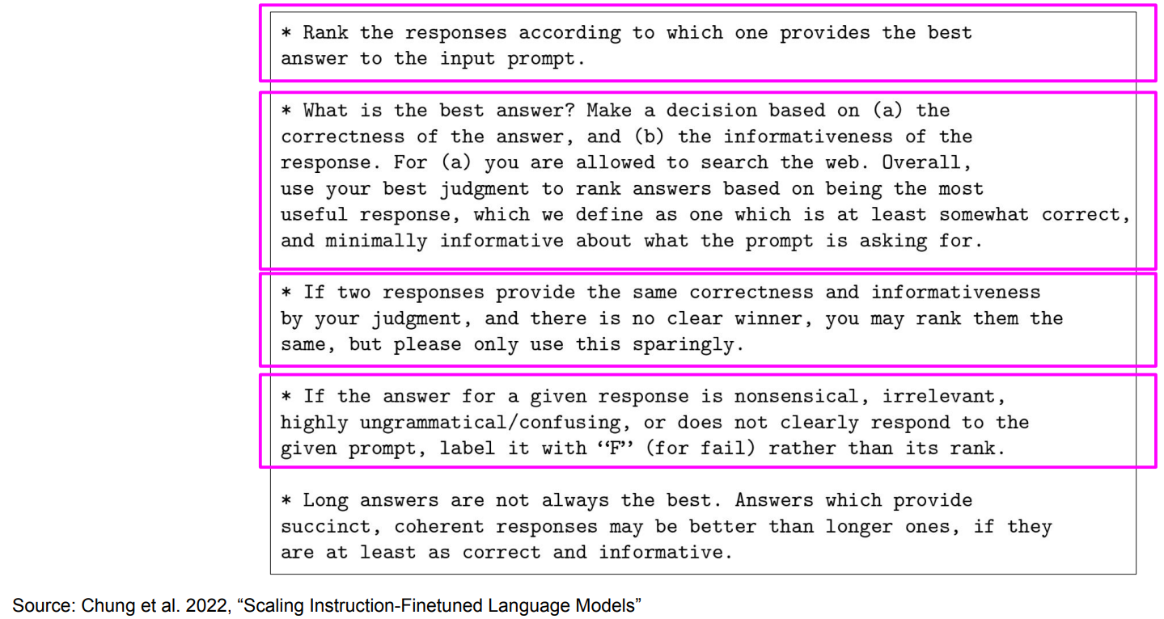
Sample instructions for human labelers

Slide 30
LLM size

Slide 31
Model size
# of Tokens:
The more text you feed a language model to train on, the better it is at providing human-like outputs across a large variety of domains.
# of Parameters:
The more parameters a model has, the larger its capacity to capture intricate nuances of language.

Slide 32
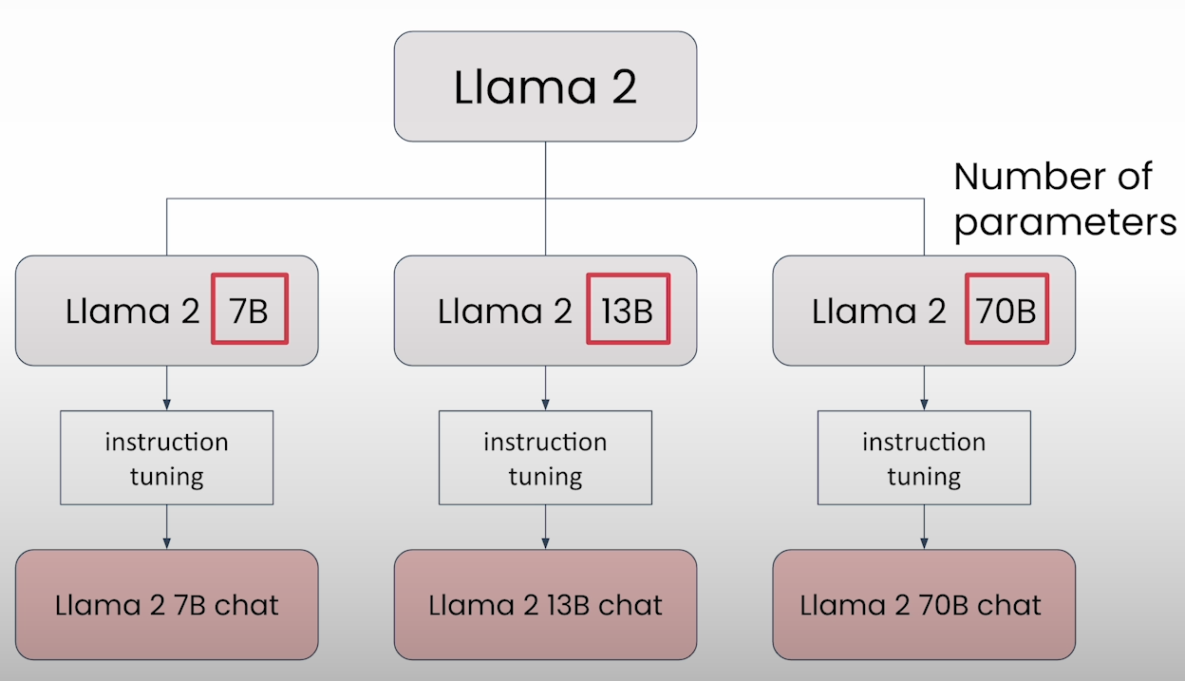
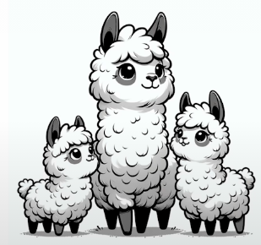
LLM Size (Llama 2)
Model size is identified by the number of parameters

Slide 33
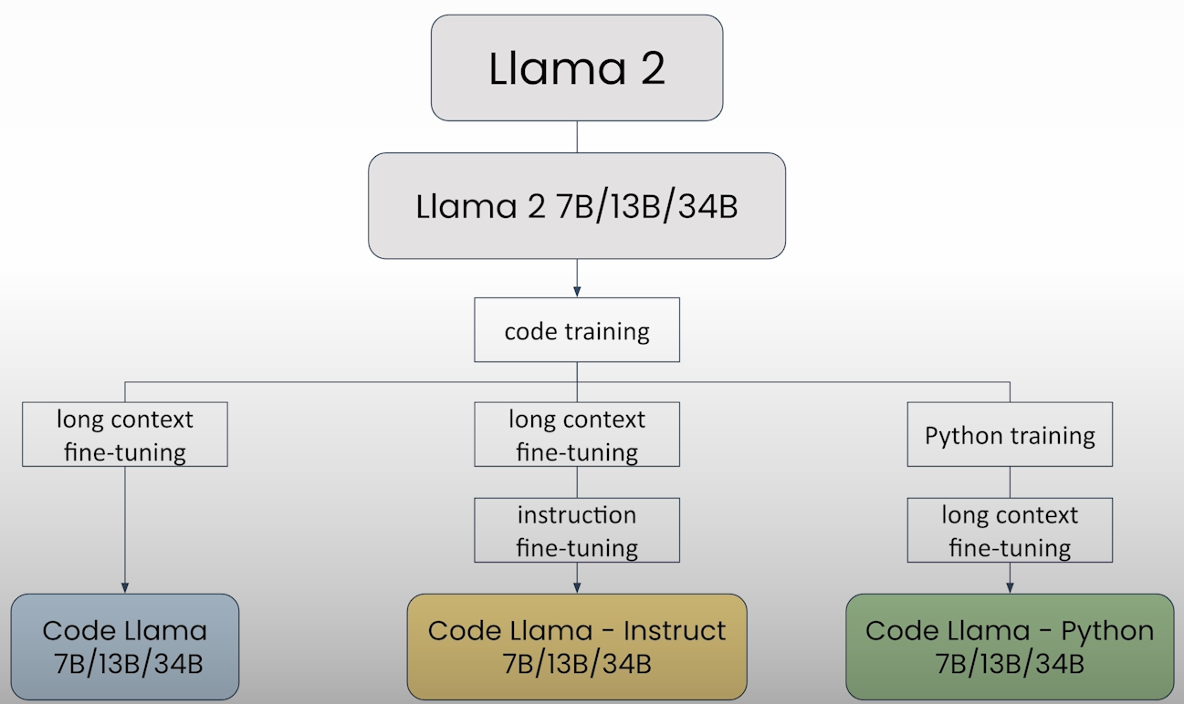
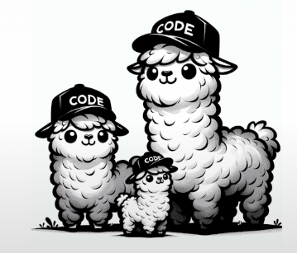
LLM Size (Code Llama 2)

Slide 34
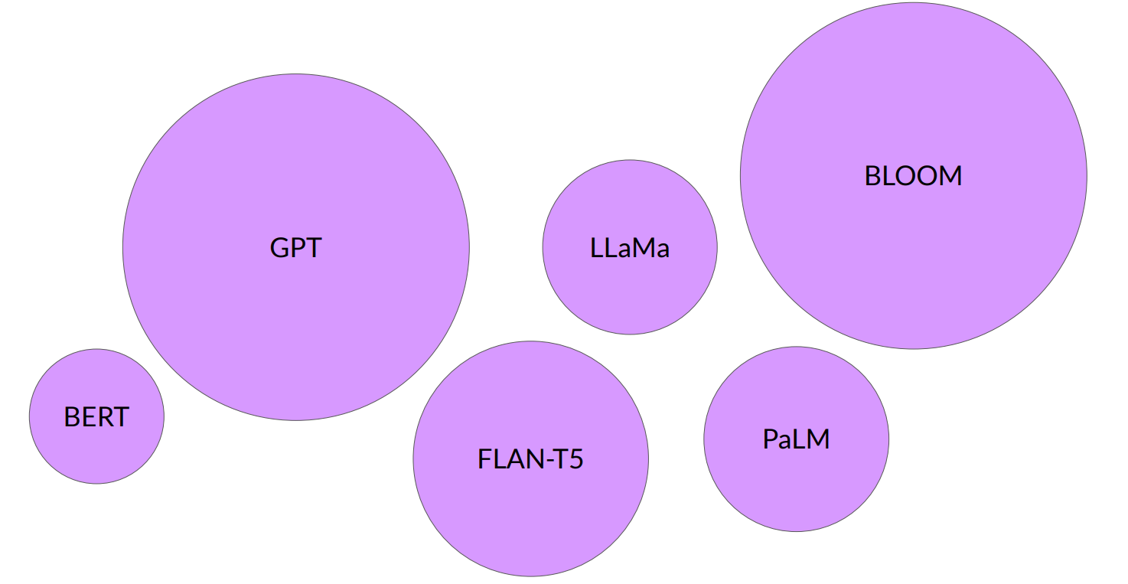
Large Language Models

Slide 35

The significance of scale: language understanding

Slide 36
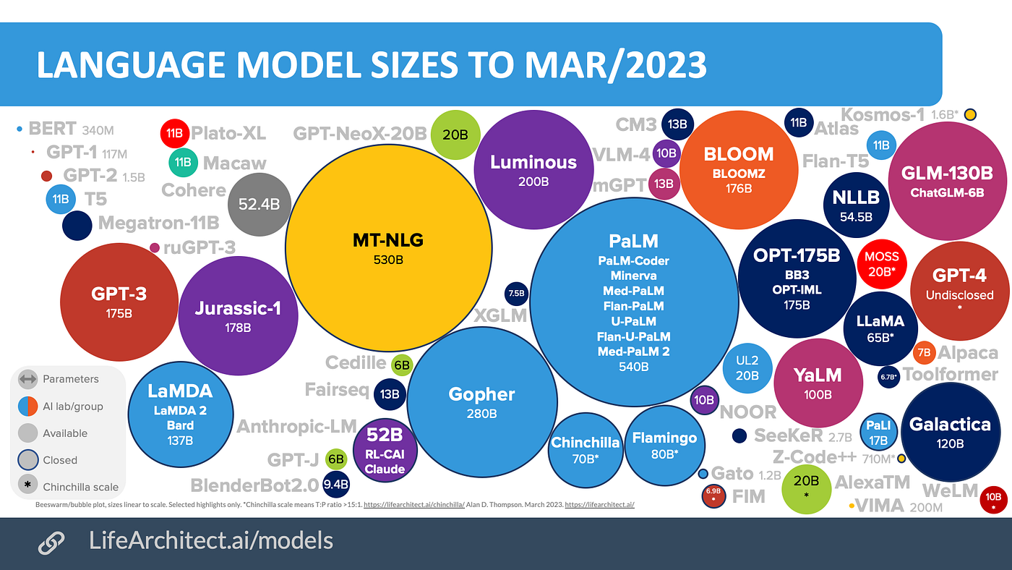

Slide 37
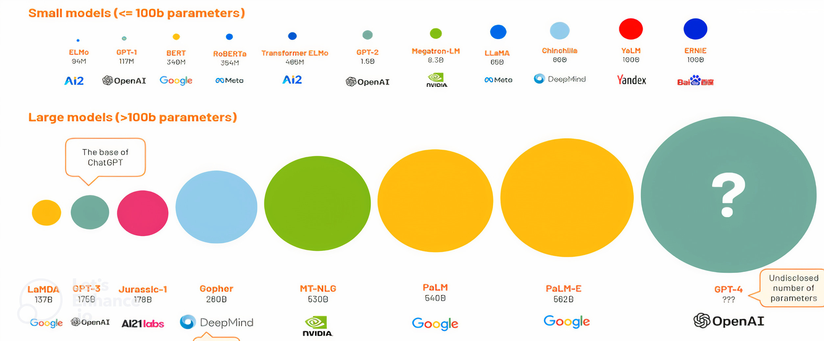
model size (# of parameters)
LLMs becoming small!!

Slide 38
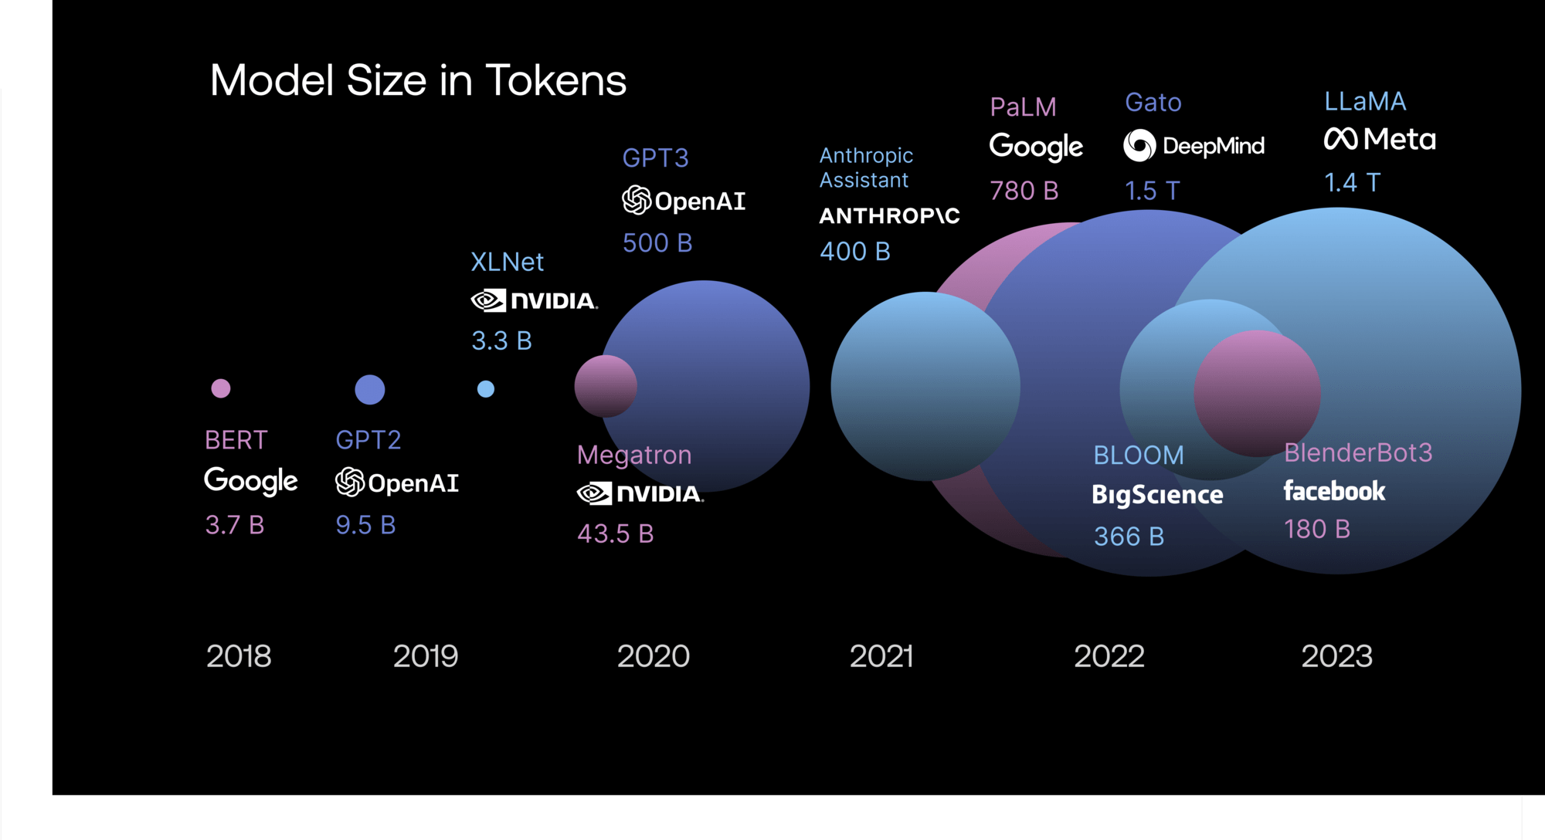
model size (# of tokens)

Slide 39
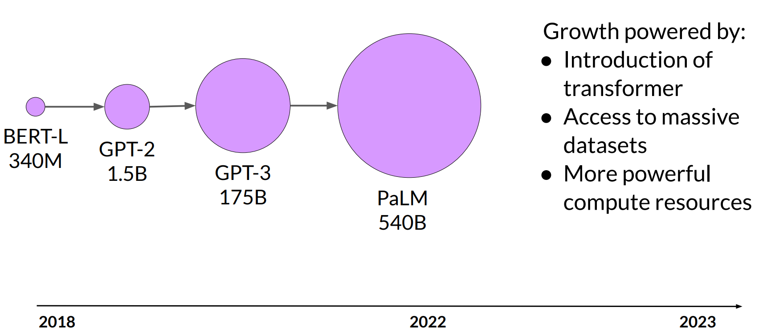
Model size vs. time

Slide 40
Model size
Parameters
~1B | Pattern matching and basic knowledge of the world.
~10B | Greater world knowledge. Can follow basic instructions
~100B+ | Rich world knowledge. Complex reasoning

Slide 41
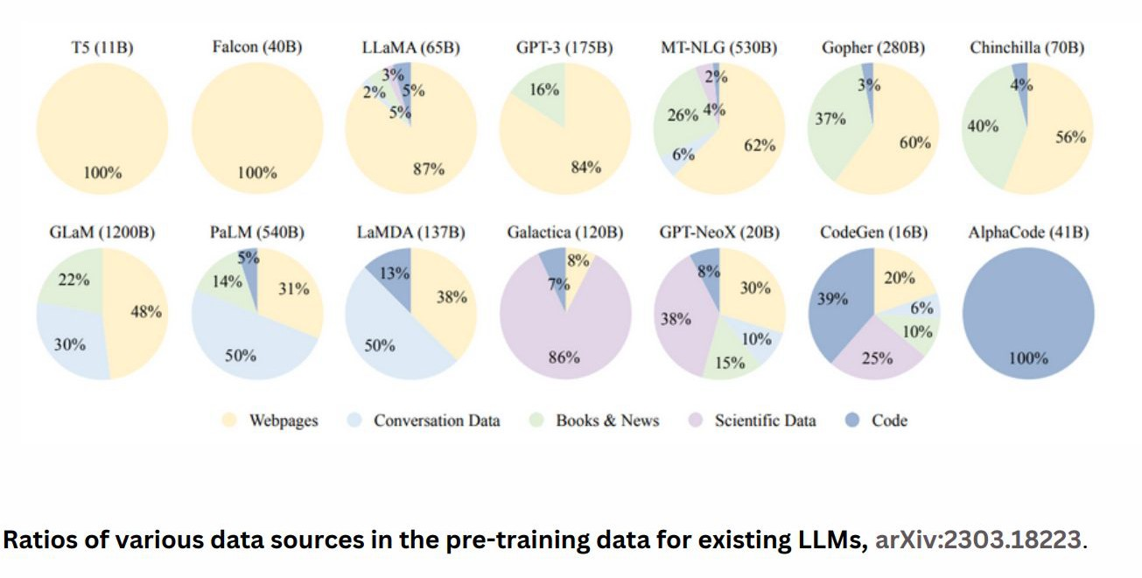
Training data domain

Slide 42
Technical Factors in choosing a LLM
Deciding which provider and foundational model would be a better choice depends on several factors including number of parameters, size of context window, training type, inference speed, cost,
fine-tunability as well as data security.
Number of Parameters: The number of parameters in a model can influence its capacity and performance. Larger models with more parameters often have the potential to capture more complex patterns and achieve higher accuracy. However, larger models also require more computational resources for training and inference.
Size of Context Window: The context window refers to the amount of text or context that the model considers when generating responses or predictions. Models with larger context windows have a broader understanding of the context, which can be advantageous for generating more contextually relevant outputs. However, larger context windows can also increase computational requirements and inference time.

Slide 43
Technical Factors in choosing a LLM
Training Type: Different models can be trained using various methods, such as supervised learning, unsupervised learning, or self-supervised learning. The training type can impact the model's capabilities and generalization across different tasks. Understanding the training methodology and evaluating its suitability for specific use cases is important.
Inference Speed: Inference speed is a crucial factor, especially in real-time or latencysensitive applications. Faster inference speeds allow for more responsive systems and better user experiences. Models with smaller architectures or optimized implementations tend to have faster inference times.
Cost: The cost of using a particular LLM includes considerations such as licensing fees, computational resources required for training and inference, and ongoing maintenance costs. Enterprises should evaluate the cost implications and ensure that the chosen LLM aligns with their budget and cost expectations.

Slide 44
Technical Factors in choosing a LLM
Fine-tunability: The ability to fine-tune the model to adapt it to specific use cases is valuable. Enterprises should consider the level of fine-tuning flexibility and the availability of resources and documentation for this process. Some models may offer more extensive fine-tuning capabilities than others.
Data Security: Data security is of paramount importance when working with LLMs. Enterprises should assess the data security practices of the provider, including encryption methods, access controls, and compliance with privacy regulations. Protecting sensitive data and ensuring secure handling and storage is crucial.
While all the factors mentioned pose their own challenges, one of the biggest challenges currently is striking the right balance between model performance and computational resources.

Slide 45
Closed or open source?
Closed-source
Open-source
Easy to use in applications
More large/powerful models
Relatively inexpensive
Some risk of vendor lock-in
Full control over model
Can run on your own device (on-prem, PC, etc.)
Full control over data privacy/access

Slide 46
LLM Capabilities

Slide 47
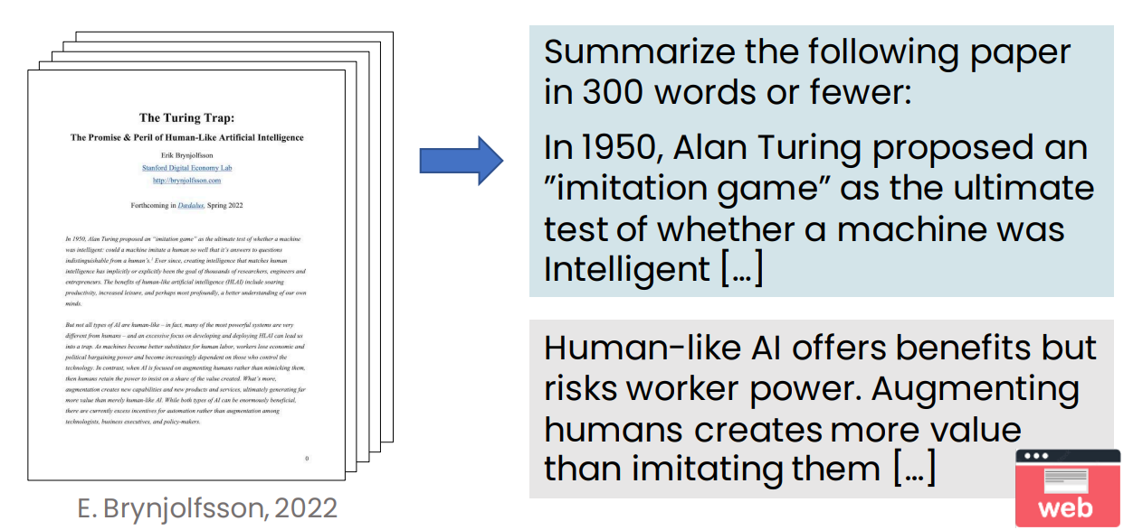
Summarizing an article

Slide 48
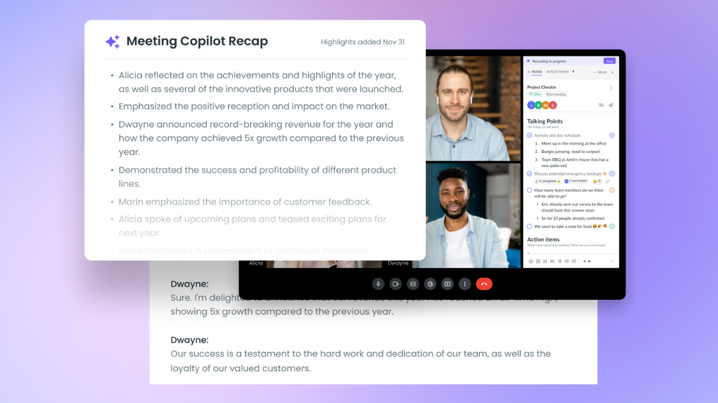
Meeting Copliot recap in MS Teams

Slide 49
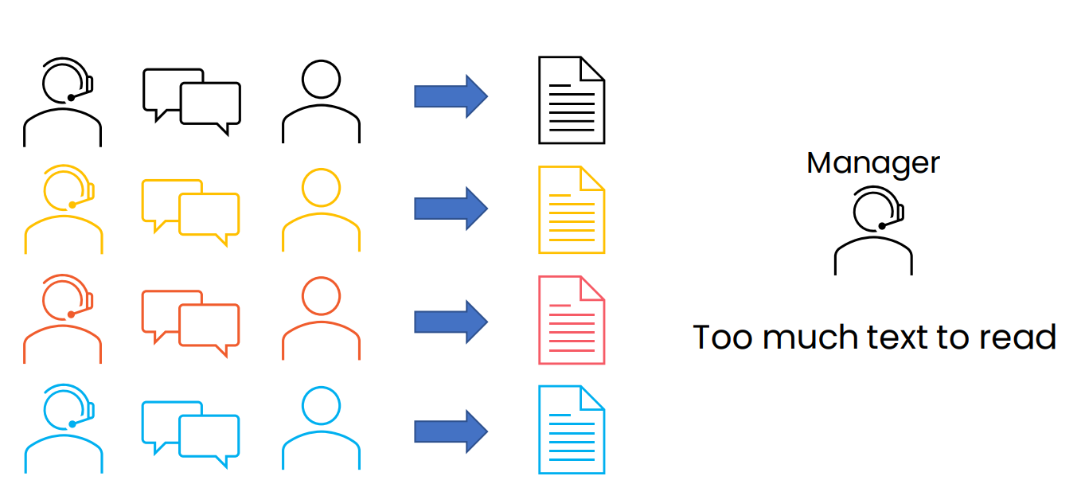
Summarizing call center conversations

Slide 50
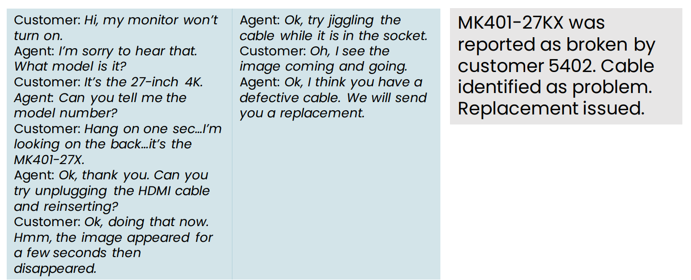
Summarizing conversations

Slide 51
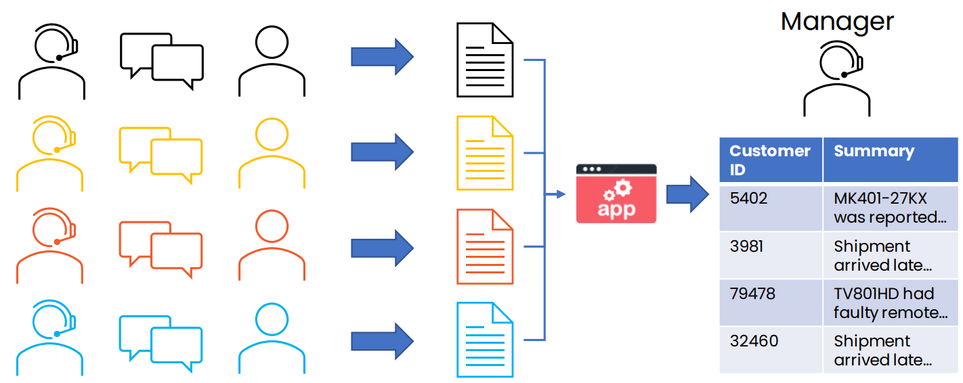
Summarizing call center conversations

Slide 52
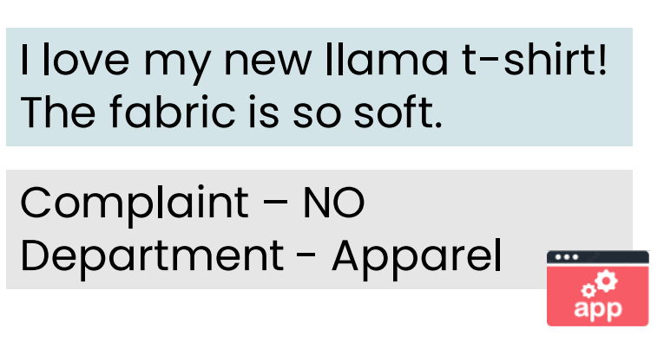
Customer email analysis

Slide 53
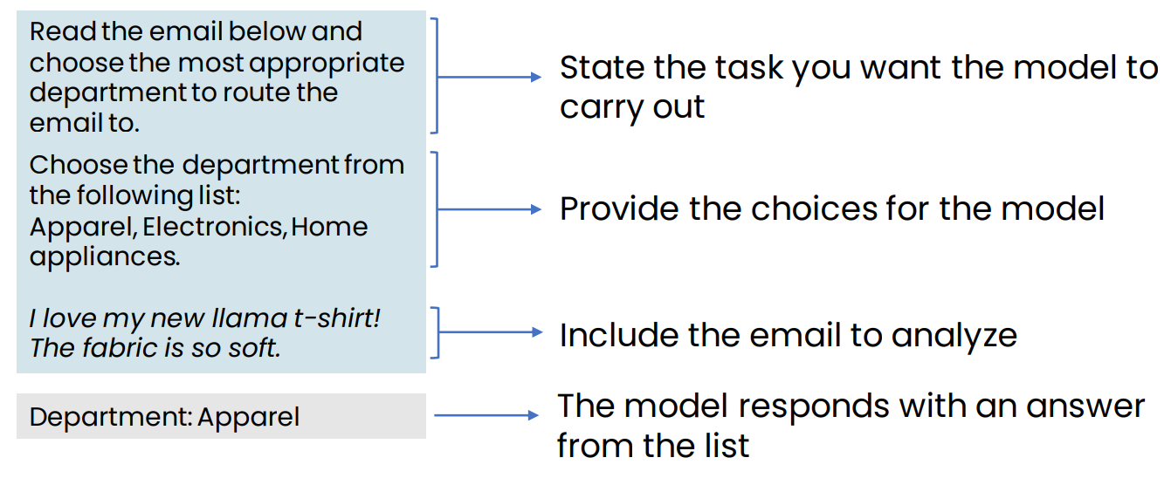
Detailed look at email routing prompt

Slide 54
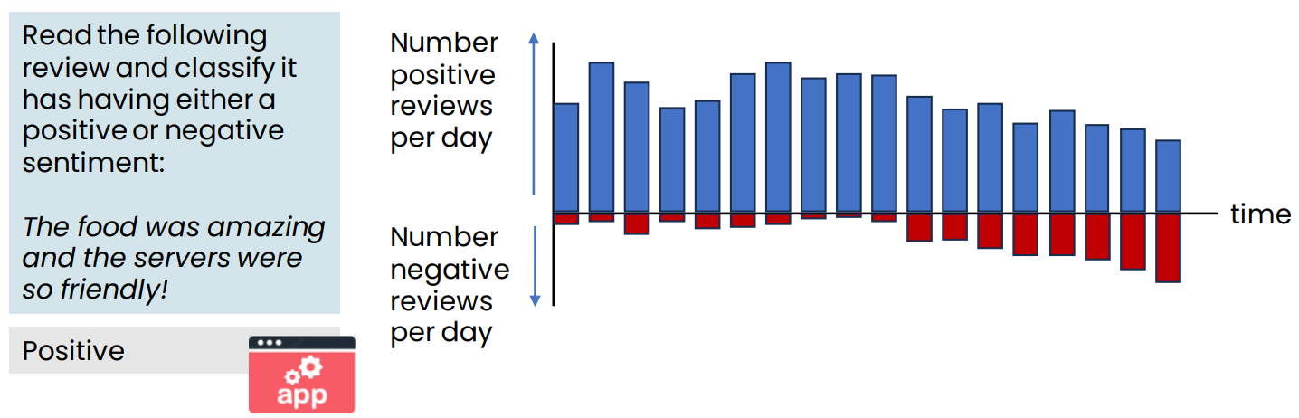
Dashboard to track customer sentiment over time

Slide 55
LLM as reasoning engine
LLMs have a lot of general knowledge, but they don’t know everything
By providing relevant context in the prompt, we ask an LLM to read a piece of text, then process it to get an answer
We’re using it as a reasoning engine to process information, rather than using it as a source of information

Slide 56
What LLMs can and cannot do

Slide 57
What LLMs are Good vs Bad at
LLMs are good at
LLMs are bad at
Language translation
Content summarization
Content generation
Writing support
Question answering
Correcting spelling and grammar
Programming support
Classification (spam detection)
Simplifying complex content
Stylized writing
Sentiment analysis
Current events
Common sense
Math/counting
Handling uncommon scenarios
Consistency
High-level strategy
Being factual 100% of the time
Reasoning & logic
Emotional intelligence
Representing minorities
Extended recall/memory

Slide 58
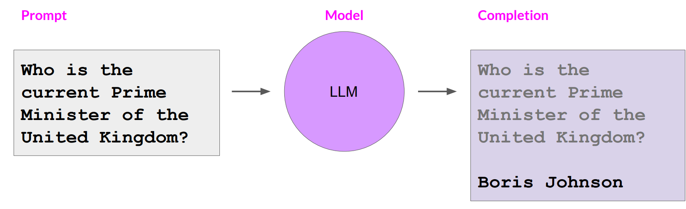
LLMs are bad at current events: Knowledge cut-offs in LLMs

Slide 59
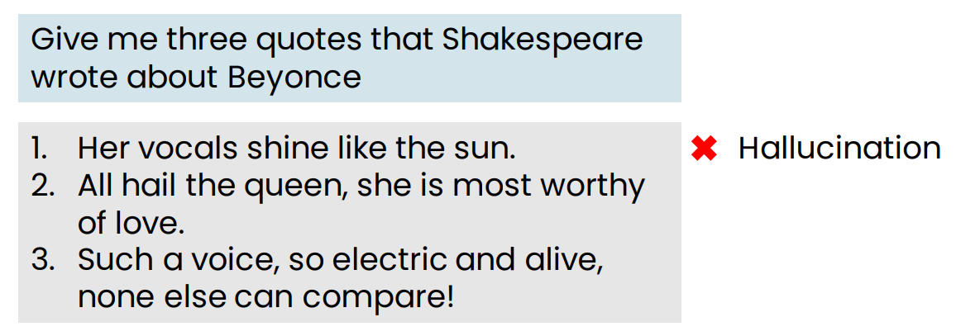
Making things up: Hallucinations

Slide 60
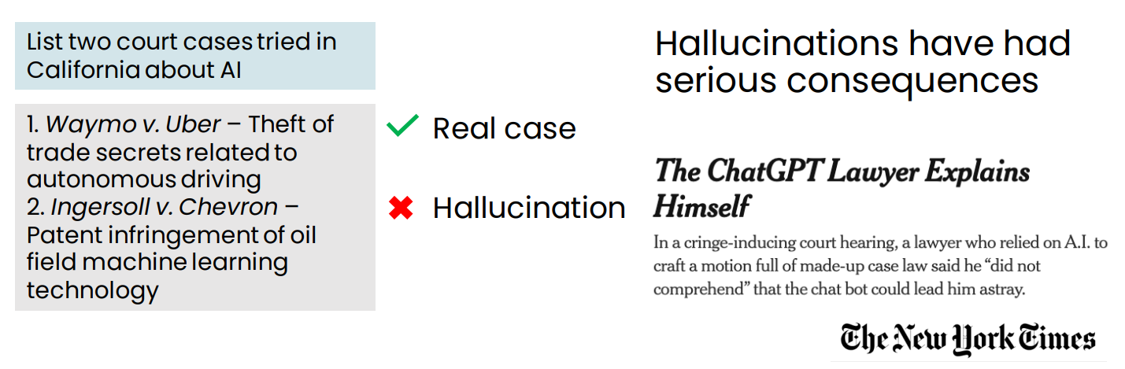
Making things up: Hallucinations

Slide 61
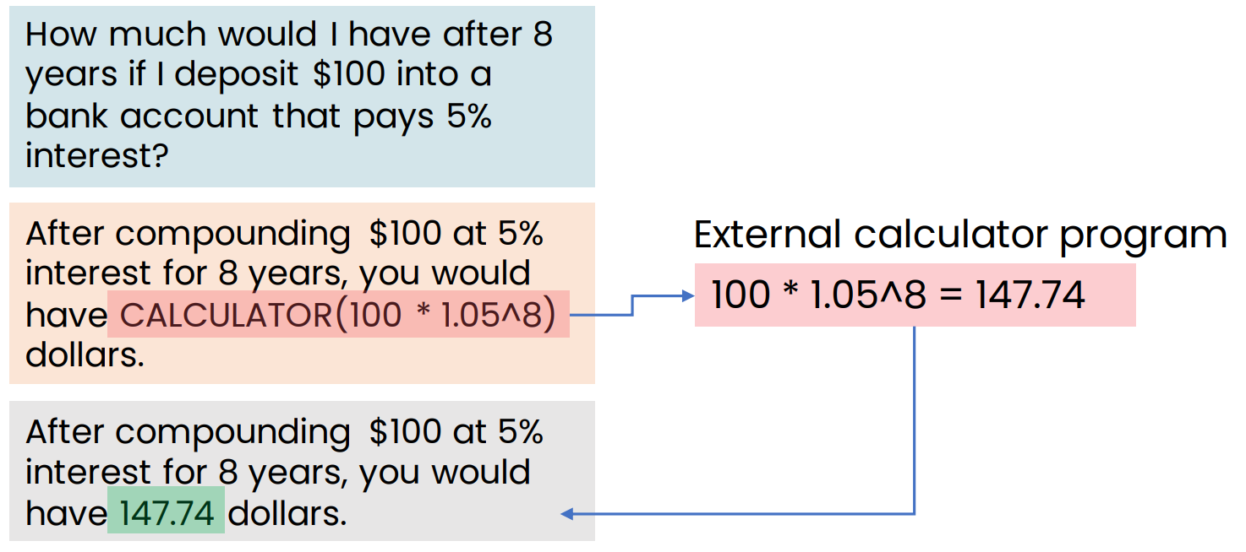
Tools for reasoning
LLM in general are bad in calculations, that is why agents are used to help.

Slide 62
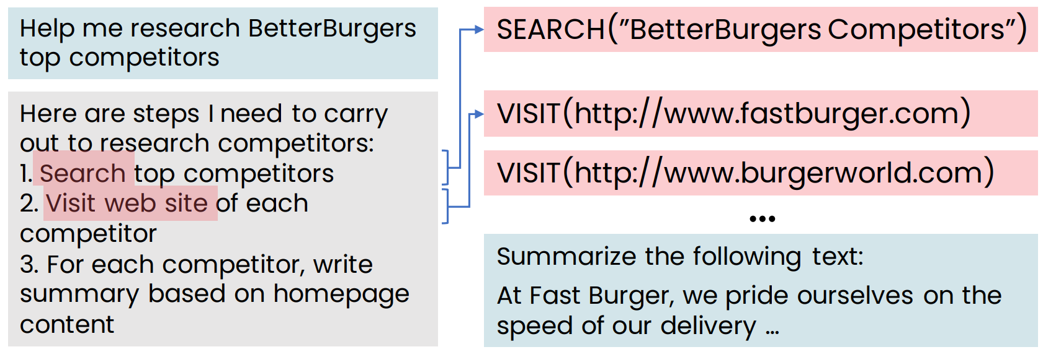
Agents
Use LLM to choose and carry out complex sequences of actions
Cutting edge area of AI research

Slide 63
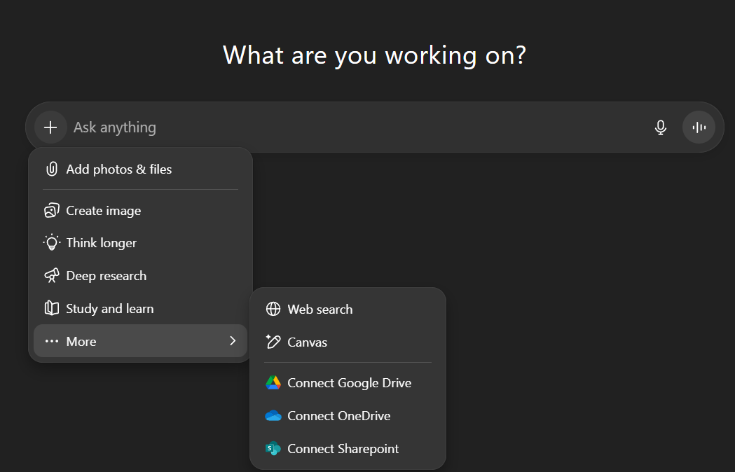
LLM + Tools

Slide 64

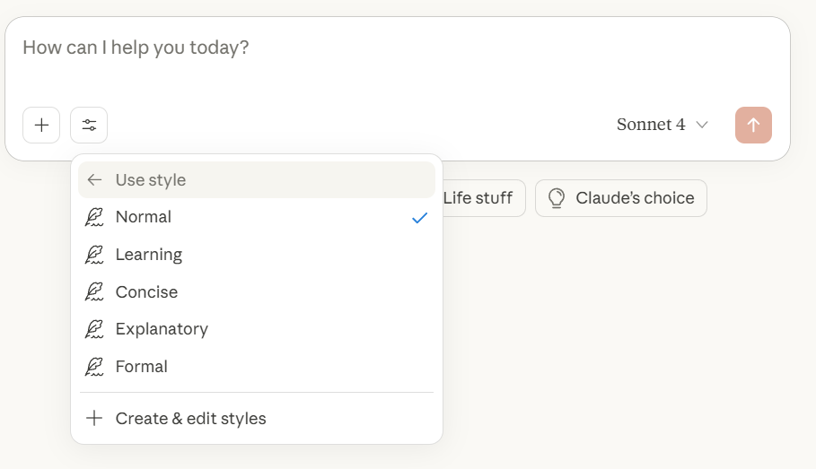
LLM + Tools

Slide 65
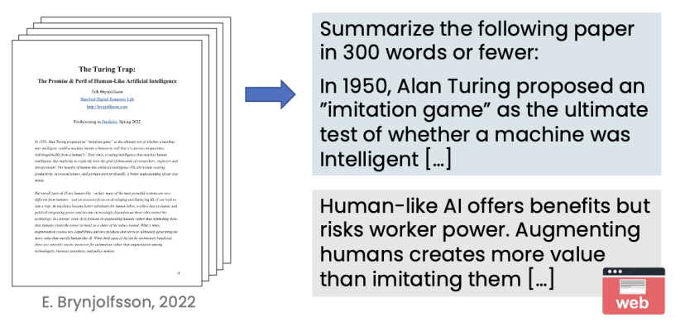
The input (and output) length is limited
Many LLMs can accept a prompt of up to only a few thousand words.
The total amount of context you can give it is limited

Slide 66
The input (and output) length is limited
Many LLMs can accept a prompt of up to only a few thousand words.
The total amount of context you can give it is limited
Some LLMs have longer context limits – up to 100,000 words
An LLM’s context length is the limit on the total input+output size

Slide 67

Comparing openAI models

Slide 68


Q&A

